Slide 1
Al-Farabi Kazakh National University
Higher School of Medicine
Mutations
Lecturer: PhD Pinsky Ilya Vladimirovich

Slide 2
LEARNING OUTCOMES
As a result of the lesson you will be able to:
1. Explain what a mutation is and its importance for evolution of life.
2. Classify and characterize the main types of mutations.
3. Define the terms: deletion, insertion, inversion, duplication, translocation, and explain what type of mutation each term belongs to and why.
4. Give the specific examples of hereditary diseases.

Slide 3
Literature
Alberts et al., pp. 485-491;
Watson, pp. 313-340;
Norris Armstrong. Decoding the Flu (case study) / Biology Department, University of Georgia. (https://sciencecases.lib.buffalo.edu/collection/detail.html?case_id=597&id=597)

Slide 4
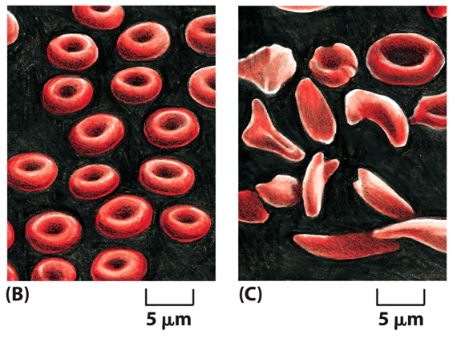
Mutations can have severe consequences for an organism.
Mutation: A permanent change in the DNA due to a failure in DNA replication or DNA repair mechanisms.
Even a single nucleotide change may cause severe diseases.
example: a life threatening disease, sickle cell anemia.
--- amino acid sequence change in β-globin chain.
--- red blood cells are more fragile and break frequently in blood stream, reduced number of cells
--- can cause weakness, dizziness, pain etc.
Cells from sickle cell anemia patient
Normal red blood cells

Slide 5
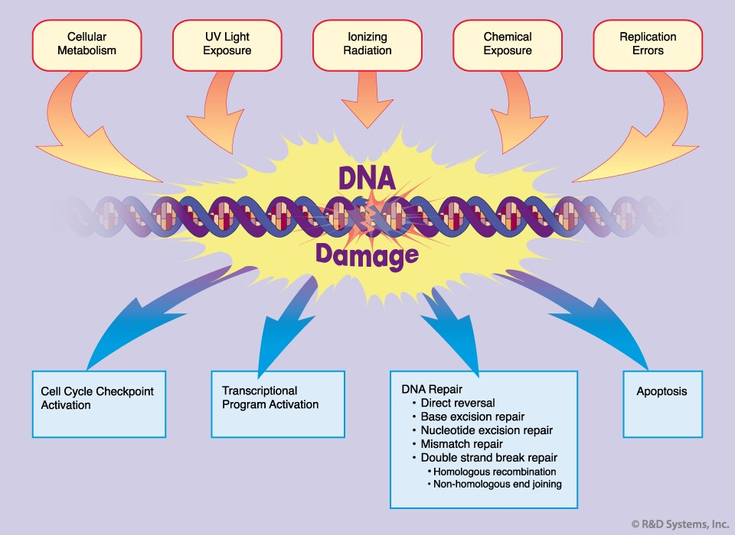
In bacterium E. coli, more than 50 genes are known that control repair processes.
Every day in the DNA molecules of each cell of the human body about 100,000 units are damaged due to a variety of endogenous processes and exogenous genotoxic effects.
Less than 1 DNA damage out of 1000 turns into a mutation.

Slide 6
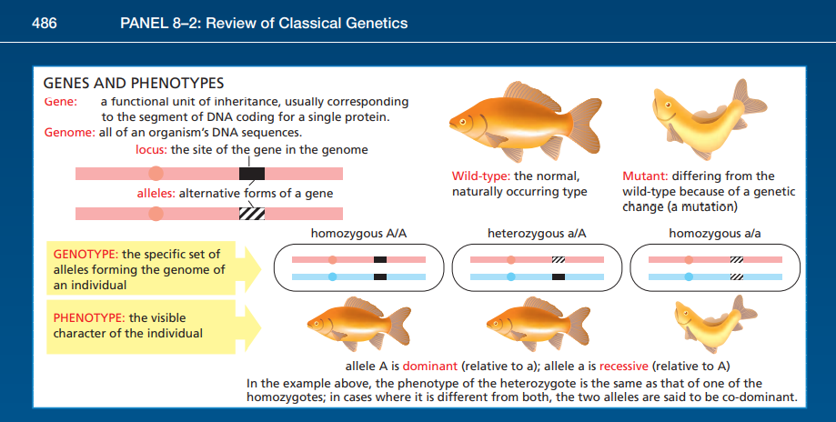

Slide 7
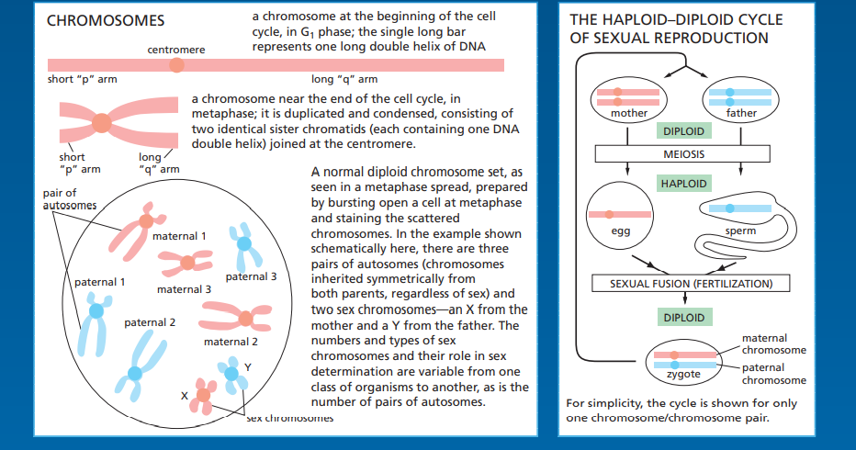

Slide 8
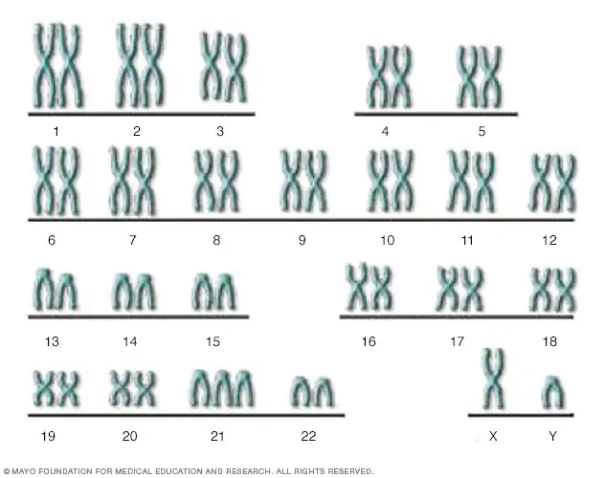
The Down syndrome.

Slide 9
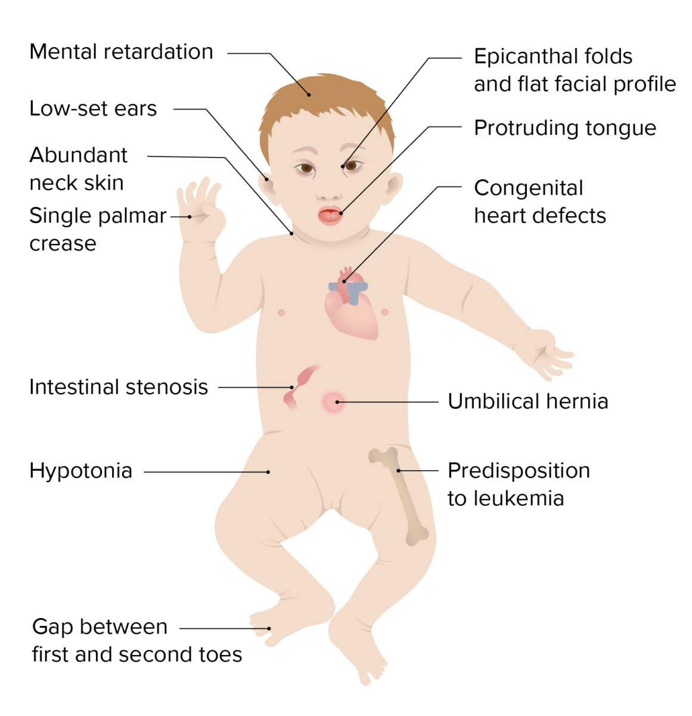
lecturio.com

Slide 10
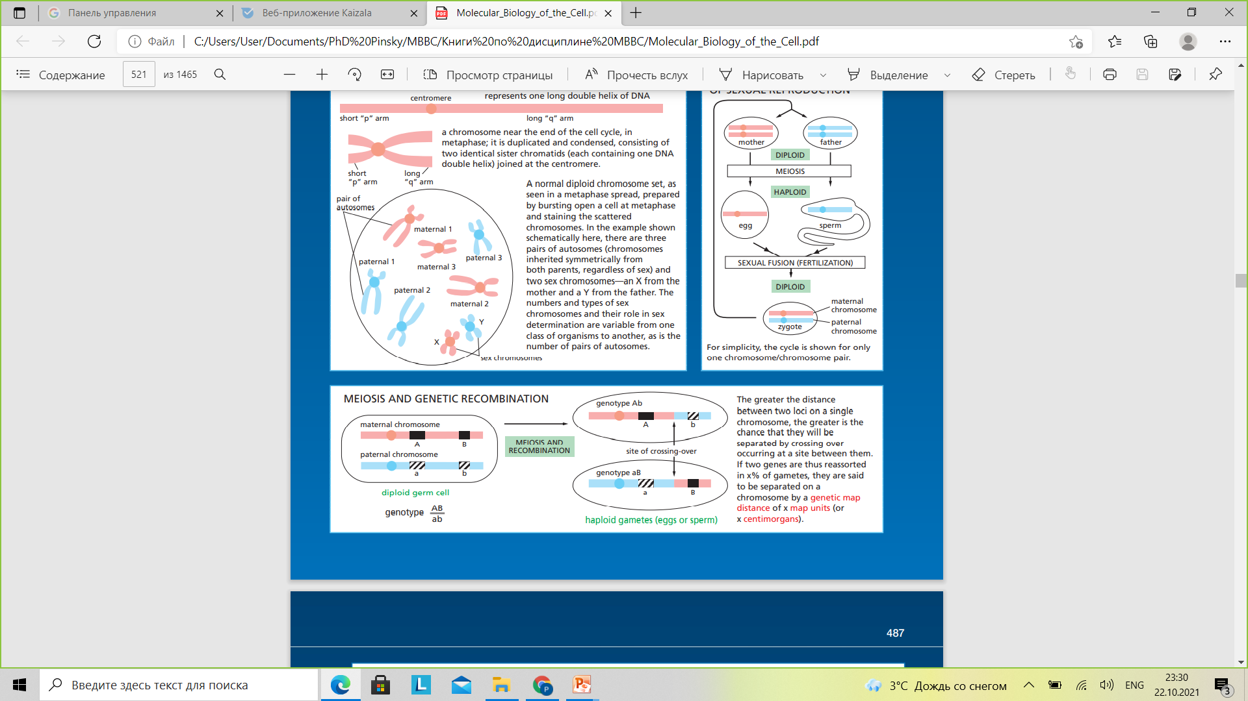

Slide 11
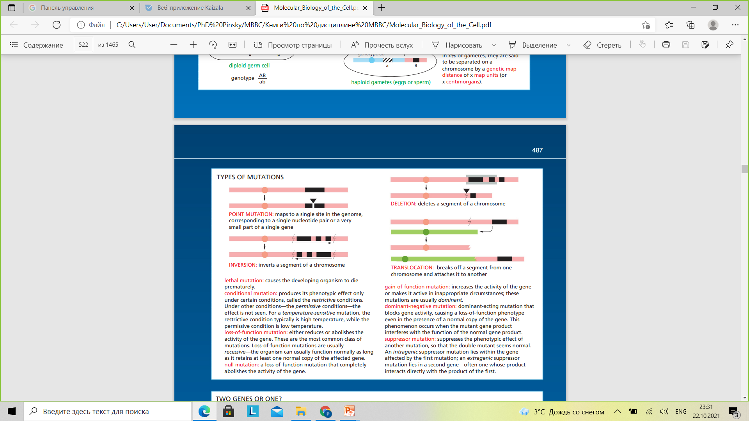

Slide 12
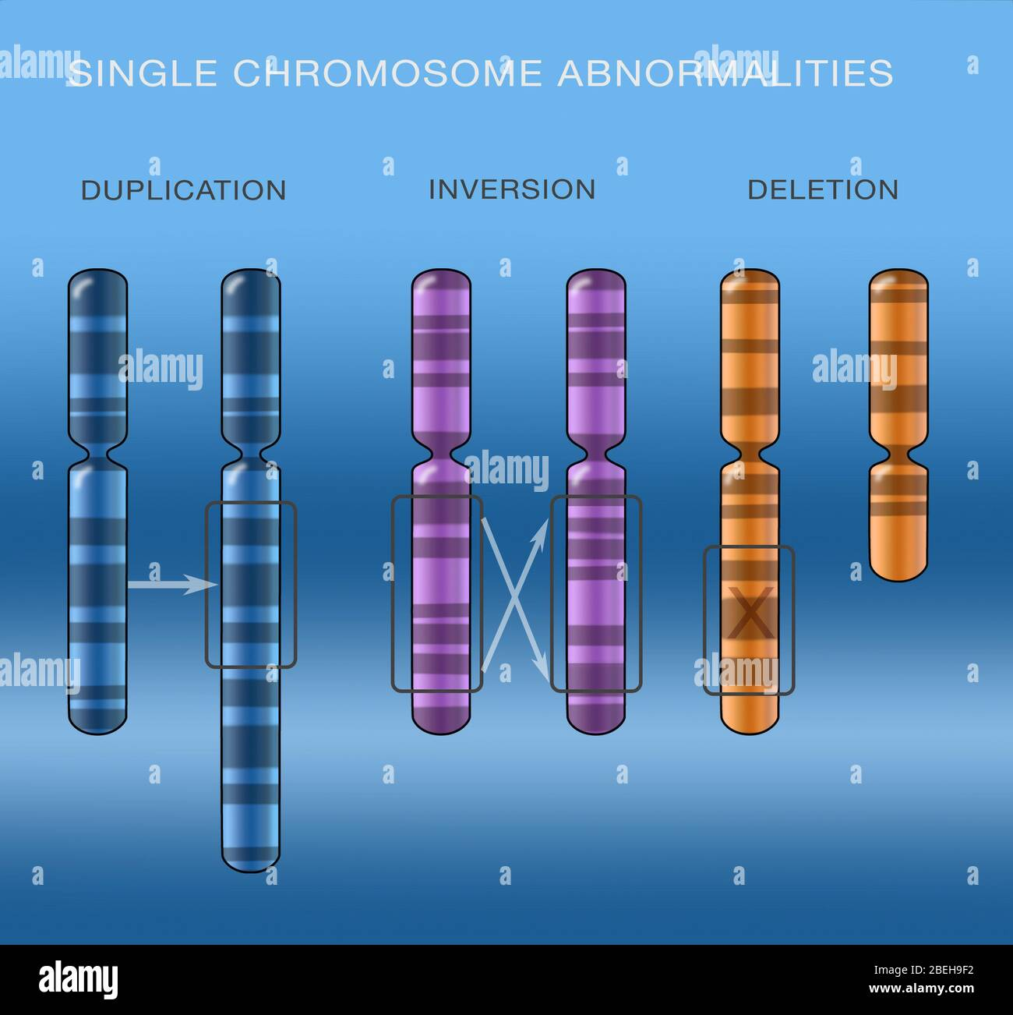

Slide 13
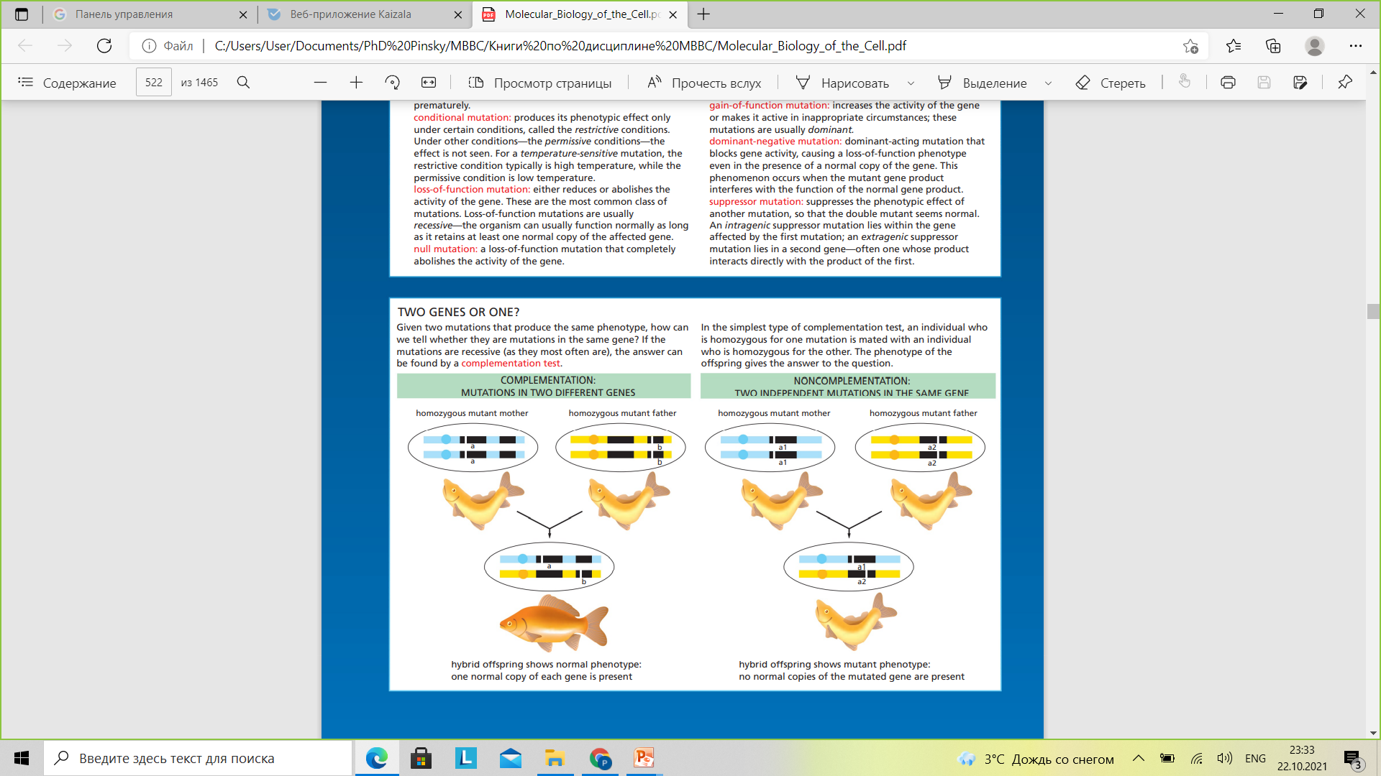

Slide 14
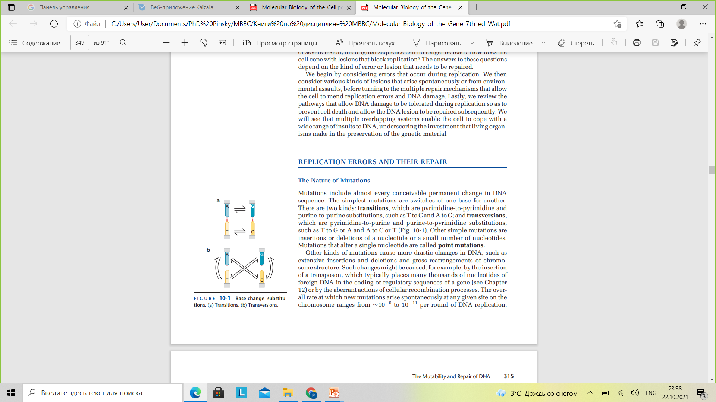

Slide 15
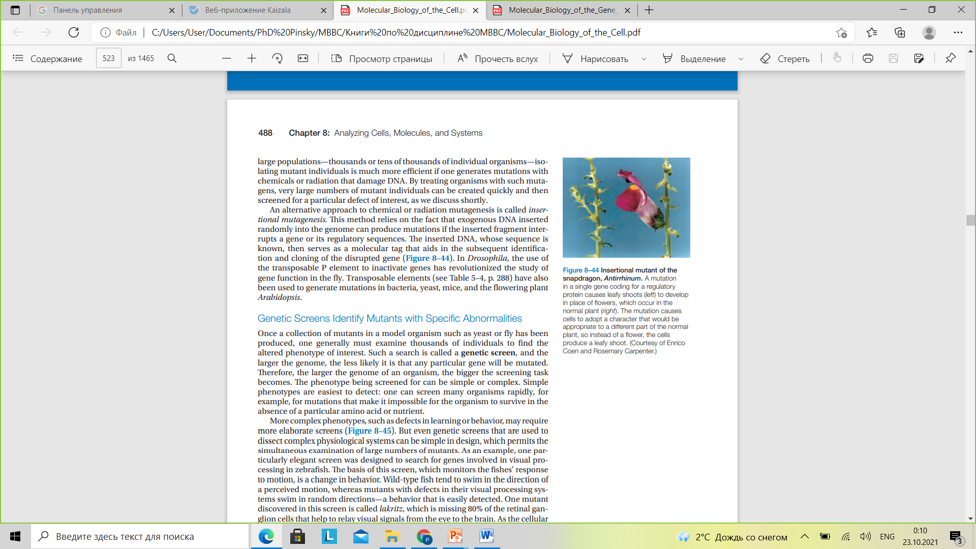

Slide 16
Typical HA RNA
5’UAACCAUGAAGACUAUCAUUGCUUUGAGCUACAUUC 3
Leu
Strain #2 RNA
5’UAACCAUGAAGACUAUCAUUGCUUAGAGCUACAUUC 3’
Stop
Non-Sense Mutation (truncation)
https://sciencecases.lib.buffalo.edu/collection/detail.html?case_id=597&id=597

Slide 17
Typical HA RNA
5’UAACCAUGAAGACUAUCAUUGCUUUGAGCUACAUUC 3
Lys
Strain #1 RNA
5’UAACCAUGAGGACUAUCAUUGCUUUGAGCUACAUUC 3’
Arg
Mis-Sense (substitution) Mutation
https://sciencecases.lib.buffalo.edu/collection/detail.html?case_id=597&id=597

Slide 18
Typical HA RNA
5’UAACCAUGAAGACUAUCAUUGCUUUGAGCUACAUUC 3
Thr
Strain #3 RNA
5’UAACCAUGAAGACCAUCAUUGCUUUGAGCUACAUUC 3’
Thr
Silent Mutation

Slide 19
Typical HA RNA
5’UAACCAUGAAGACUAUCAUUGCUUUGAGCUACAUUC 3
Met Lys Thr Ile Ile Ala Leu Ser Tyr Ile
Strain #4 RNA
5’UAACCAUGAAGACAUCAUUGCUUUGAGCUACAUUC 3’
Met Lys Thr Ser Leu Leu STOP
Frame Shift Mutation
Notes:
19
Image by Cynthia Goldsmith, obtained from Wikipedia Commons: http://commons.wikimedia.org/wiki/File:Influenza_virus_particle_color.jpg. This media originally comes from the Centers for Disease Control and PreventionImage by Cynthia Goldsmith, obtained from Wikipedia Commons: http://commons.wikimedia.org/wiki/File:Influenza_virus_particle_color.jpg. This media originally comes from the Centers for Disease Control and Prevention's Public Health Image Library (PHIL), with identification number #10073. Public domain.

Slide 20
